Slide 1
Nigeria Population Data (2006 & 2019)

Slide 2
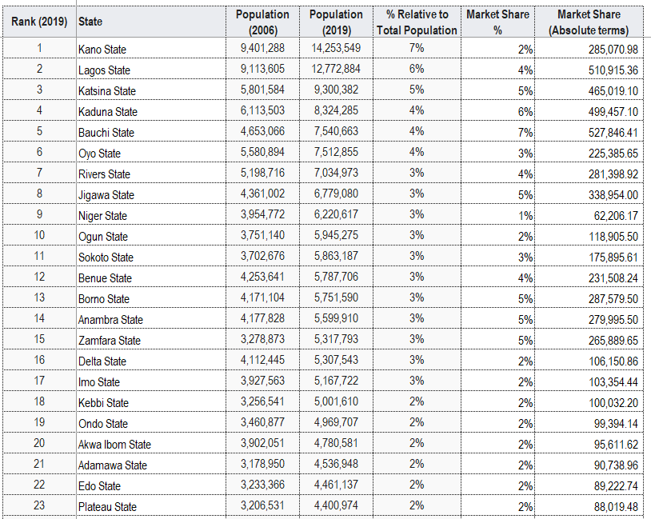
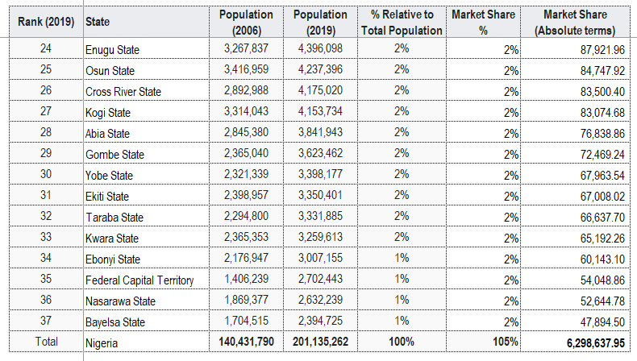
Population: Ranking

Slide 3
